Slide 1
Computer Network
OSI Model

Slide 2
Why a Layered Model ?
Easy to understand
Reduces complexity
Standardization across manufactures
Allows different hardware and software to work together
Speed Development
Changes in one layer does not affect how other level works

Slide 3
The OSI Model
OSI “ Open Systems Interconnection".
OSI model was first introduced in 1984 by the International Organization for Standardization (ISO).
Outlines WHAT needs to be done to send data from one computer to another.
Not HOW it should be done.
Protocols stacks handle how data is prepared for transmittal (to be transmitted)
In the OSI model, The specification needed
are contained in 7 different layers that interact with each other.
https://www.youtube.com/watch?v=vv4y_uOneC0

Slide 4
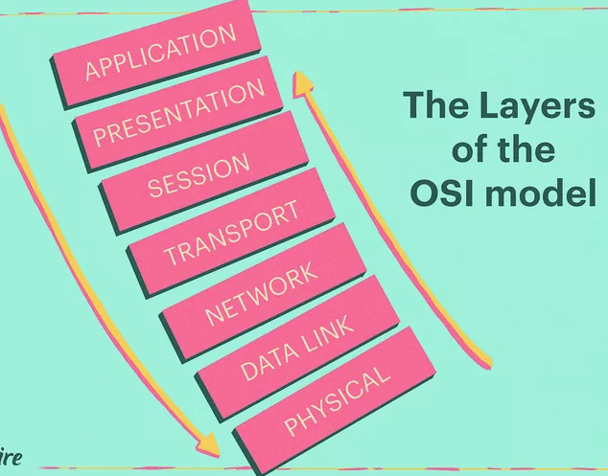
OSI Reference Model
The OSI model
is a theoretical blueprint that helps us understand how data gets from one user’s computer to another.
It aids standardization of networking technologies by providing an organized structure for hardware and software developers to follow, to insure there products are compatible with current and future technologies.
It is also a model that helps develop standards so that all of our hardware and software talks nicely to each other.

Slide 5
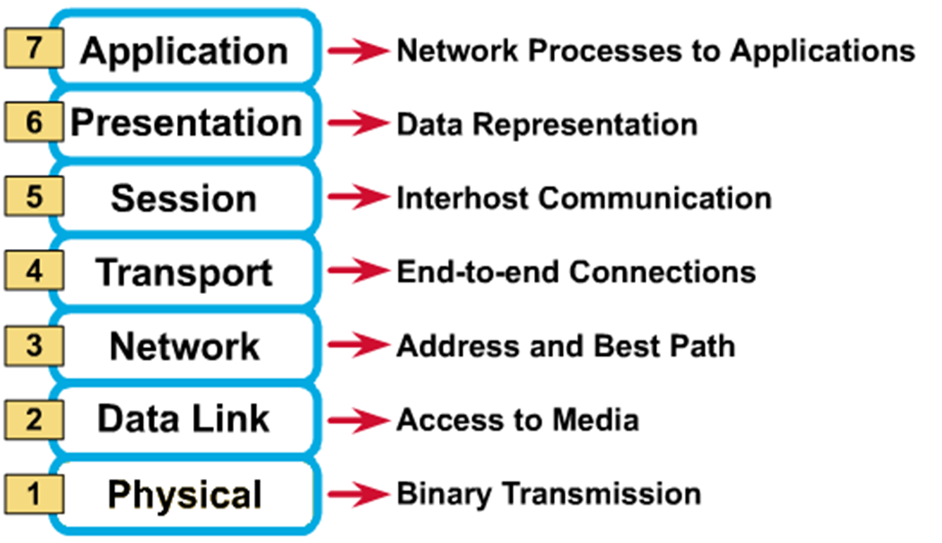
7 Layer Model
Network Support
Layer
User Support
Layer

Slide 6
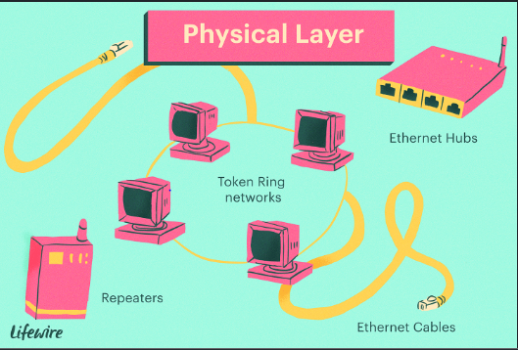
Physical Layer
The physical layer is responsible for movements of bits
from one hop (node) to the next
individual
Physical characteristics of interfaces and
transmission media
Representation of Bits (type of encoding)
Data Rate (bps)— Numbers of bits transmitted
Synchronization of bits– Bit level
Line configuration- point-to-point or multi point
Physical Topology
Transmission Mode- Communication mode

Slide 7
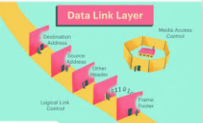
Data Link Layer
The data link layer is responsible for moving frames from one hop (node) to the next.
Framing
Physical Addressing– Add header/trailer to identify
sender and receiver
Flow Control
Error Control
Access Control– when two or more devices are linked on a same link , it ensures which device has control over the link.

Slide 8
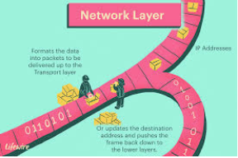
Network Layer
The network layer is responsible for the delivery of individual
packets from the source host to the destination host.
Logical Addressing
Routing

Slide 9
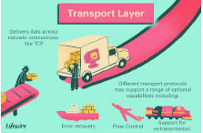
Transport Layer
The transport layer is responsible for the delivery of a message from one process to another.
Segmentation and reassembly-
Service point addressing– entire message
should reach to correct destination.
Connection Control
Flow Control
Error Control

Slide 10
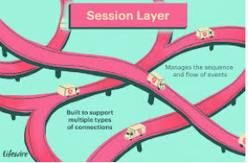
Session Layer
The session layer is responsible for dialog control and synchronization.
Dialog Control- Allow communication to take place either in half and full duplex mode.
Synchronization– Allow processes to add checkpoints into stream of data

Slide 11
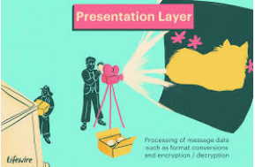
Presentation Layer
The presentation layer is responsible for translation, compression and encryption
Translation– Info changed into bit streams.
Compression
Encryption

Slide 12
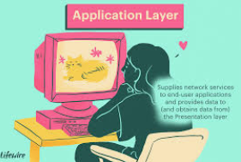
Application Layer
The application layer is responsible for providing services to the user.
Network virtual terminal
File transfer, Access & Management
Mail Services
Directory Services

Slide 13
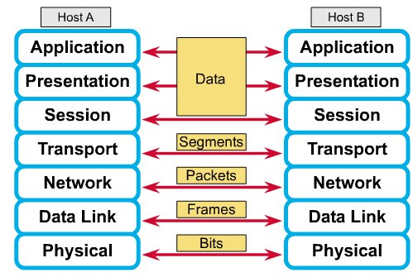
How does it All Work Together ?
Each layer contains a Protocol Data Unit (PDU)
PDU’s are used for peer-to-peer contact between corresponding layers
Data is handled by the top three layers, then Segmented by the Transport layer.
The Network layer places it into packets and the Data Link frames the packets for transmission.
Physical layer converts it to bits and sends it out over the media.
The receiving computer reverses the process using the information contained in the PDU.

Slide 14
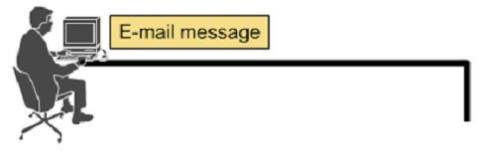
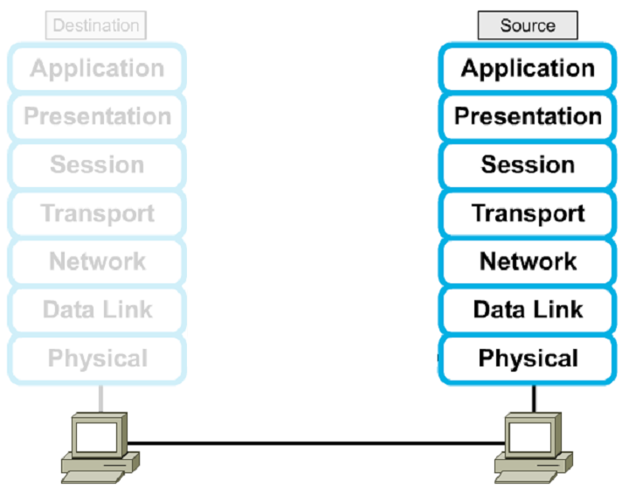







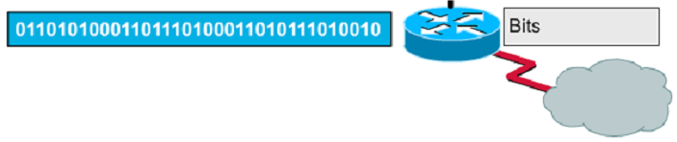

Encapsulation Example : Email
The data link layer is (node) to the next.
Framing

Slide 15


The Postal Analogy
A- Write a 20 page letter to a foreign country.
P- Translate the letter so the receiver can read it.
S- Insure the intended recipient can receive letter.
T- Separate and number pages. Like registered mail, tracks delivery and requests another package if one is “lost” or “damaged” in the mail.
N- Postal Center sorting letters by zip code to route them closer to destination.
D- Local Post Office determining which vehicles to deliver letters.
P- Physical Trucks, Planes, Rail, autos, etc which carry letter between stations.
Application
Presentation
Session
Transport
Network
Data-Link
Physical

Slide 16
TCP/IP Model development
Why is it Required ?
Internet Runs over this model
Inter Networking of devices is possible
Based on OSI Layered Model
Describe protocols on each Layer
In late-60s DARPA developed TCP/IP

Slide 17
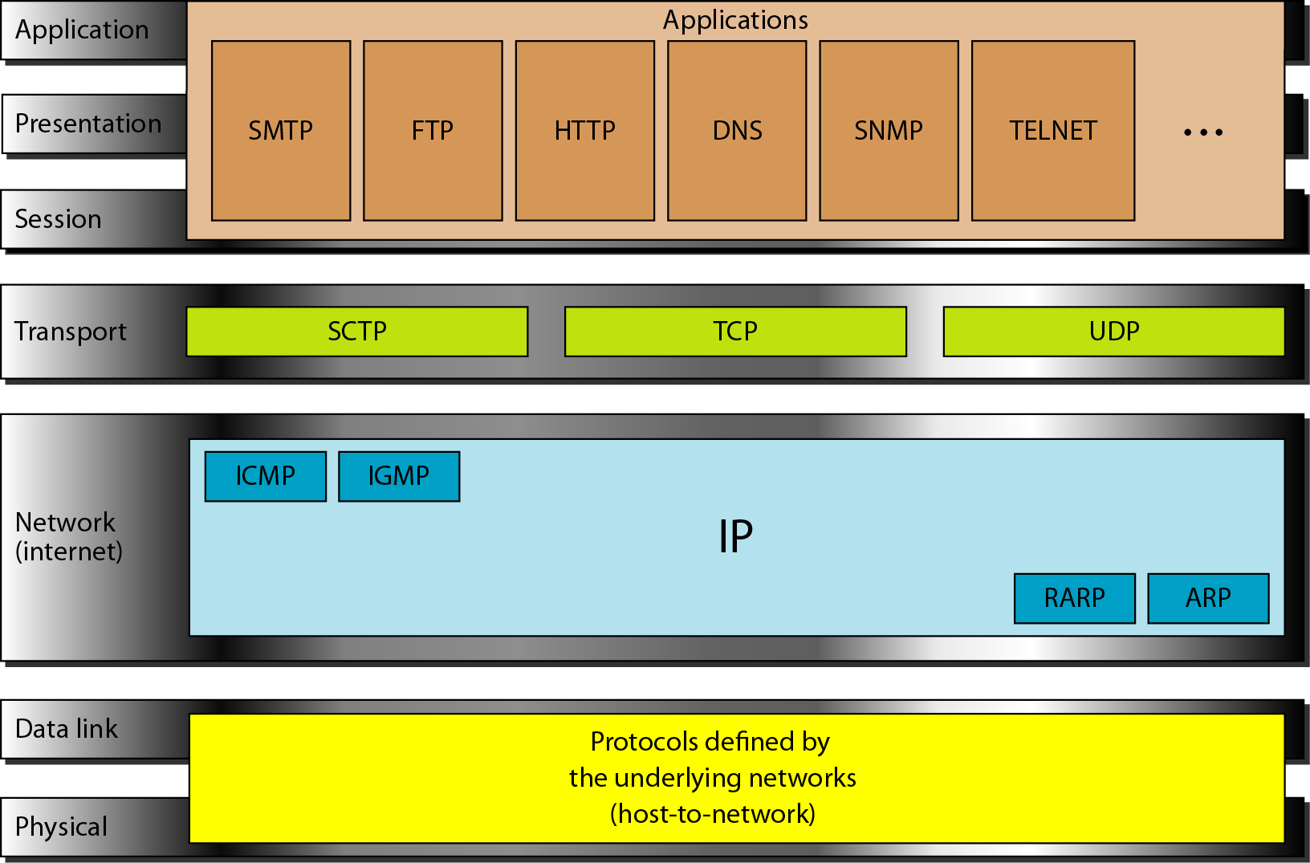
TCP/IP- A Four Layer Model
This layer combines functionalities of the three top layers of the OSI model and may also be called Process/Application layer. Some of the most popular applications (email, file transport, and so on) interface with this layer to communicate with other applications on the network.
The Transport layer corresponds with the Transport layer of the OSI model and is also known as the Host-to-Host layer. Not only is this layer responsible for reliable data delivery.
The Internet layer corresponds with the Network layer of the OSI model. IP uses logical or virtual addressing to get a packet from a source to its destination. IP addresses are used by routers to make forwarding decisions.
This layer corresponds with the Data Link and Physical layers of the OSI model. This layer manages hardware addressing and physical data transfer.

Slide 18
TCP/IP Protocol Stack
The data link layer is (node) to the next.
Framing
Transport Layer
TCP
UDP
Internet Protocol Layer
IGMP
ICMP
Network Interface
Layer
Ethernet
Packet Radio
Application Layer
HTTP
TELNET
ARP/RARP
SCTP
FTP
SMTP
SNMP

Slide 19
How OSI and TCP/IP Model Related in Networking

Slide 20
Addresses In TCP/IP
Addresses in TCP/IP
Logical Addresses
Port Addresses
Physical Addresses
Specific Addresses

Slide 21
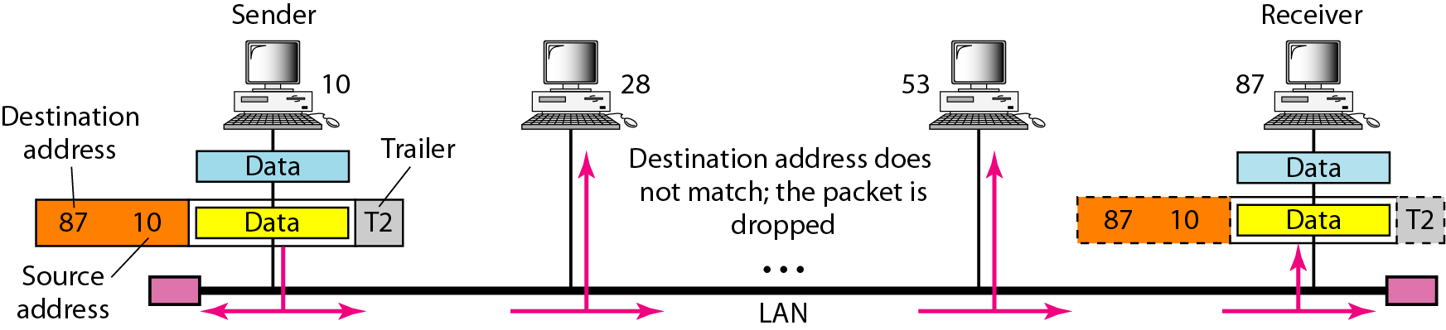
Physical Addresses
The data link layer is (node) to the next.
Framing

Slide 22
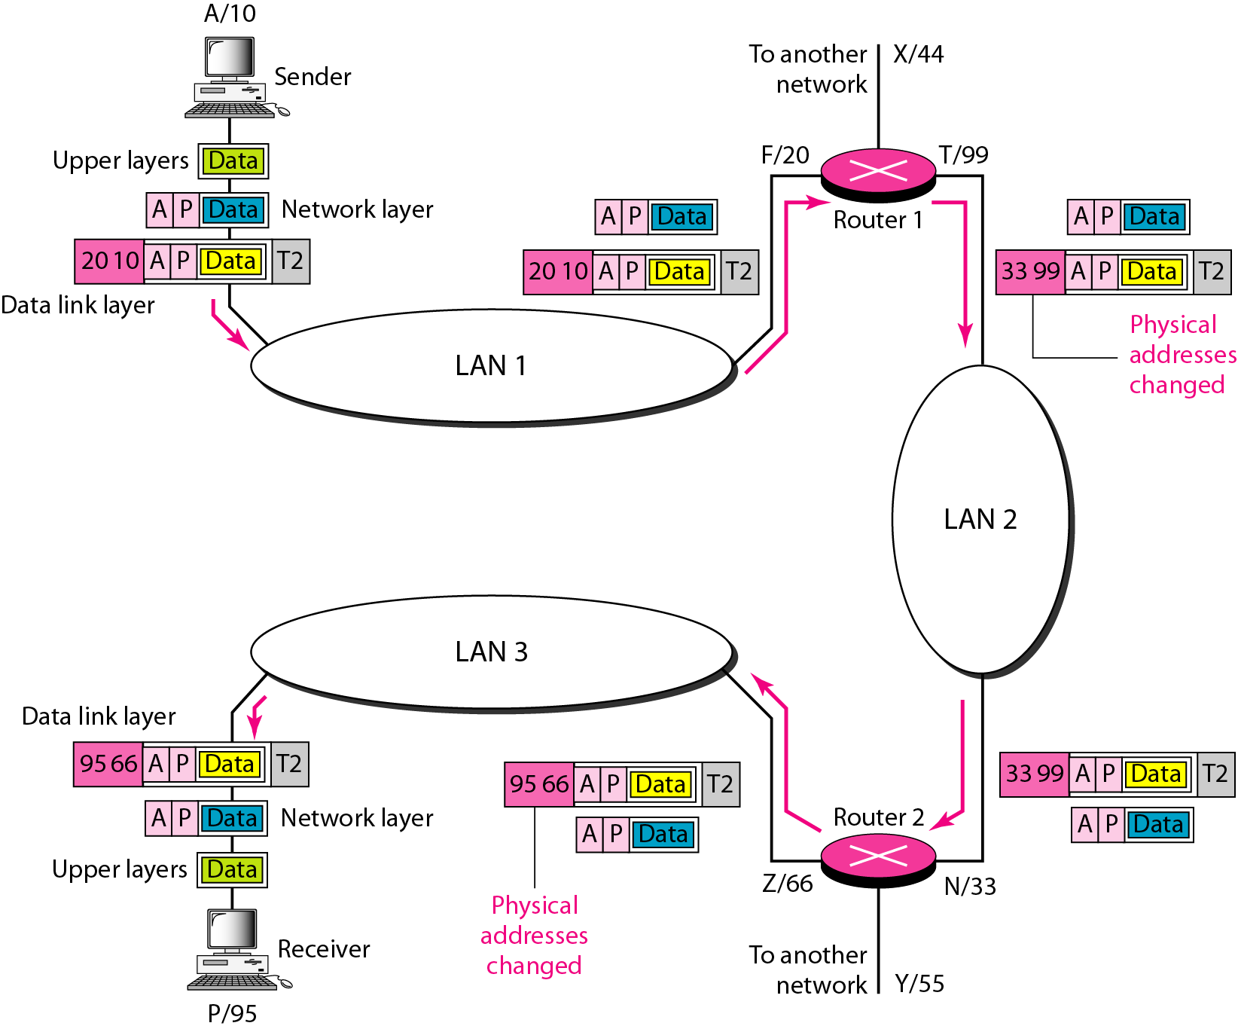
Logical Addresses
The data link layer is (node) to the next.
Framing

Slide 23
Practice Questions
Q1. Routers work at which OSI layer?
Q2. Switches work at which OSI layer?
Q3. What is a Window in networking terms?
Q4. What is the function of the Application Layer in networking?
Q5. What is the difference between TCP and UDP?
Q6. What is the port no of DNS and Telnet?
Q7. What Are Gateways In Case Of Tcp/ip?
Q8. What Is Nos (network Operating System) In Case Of Tcp/ip?
Q9. Which one is reliable – TCP or UDP ?
Q10. What is the port number of ftp (data) and ftp?

Slide 24
Practice Question Solutions
Q1. Routers work at which OSI layer?
Network Layer
Q2. Switches work at which OSI layer?
Layer 2 and Some Switches can operate at Layer 3 and above
Q3. What is a Window in networking terms?
Window is the amount of segments sent by TCP between two acknowledgements.
Q4. What is the function of the Application Layer in networking?
Application Layer is responsible for providing a user interface in between user and Network with the help of applications like web browsers.
Q5. What is the difference between TCP and UDP?
Following are differences in TCP and UDP,
TCP stands for “Transmission Control Protocol” UDP stands for “User datagram Protocol”.
TCP is connection oriented protocol while UDP is connectionless protocol.
TCP is more reliable than UDP.
UDP is faster for data sending than TCP.
UDP makes error checking but no reporting but TCP checks for errors and performs reporting.
TCP provides guaranteed Delivery of Data but UDP has no guarantee.
Header size of TCP is 20 bytes while that of UDP is 8 bytes.
TCP has acknowledgement segments but UDP has no acknowledgement.
TCP is used for application that require high reliability but less time critical whereas UDP is used for application that are time sensitive but require less reliability.

Slide 25
Q6. What is the port no of DNS and Telnet?
DNS = 53, Telnet = 23
Q7. What Are Gateways In Case Of Tcp/ip?
Gateways provide connectivity between two or more network segments. It is usually a computer that runs the gateway software and provides translation services. This translation is a key in allowing different systems to communicate on the network
Q8. What Is Nos (network Operating System) In Case Of Tcp/ip?
NOS, or Network Operating System, is specialized software whose main task is to provide network connectivity to a computer in order for it to be able to communicate with other computers and connected devices.
Q9. Which one is reliable – TCP or UDP ?
TCP is reliable.
Q10. What is the port number of ftp (data) and ftp?
FTP port number 20 (Data); 21 for Control

Slide 26
Solutions
THANKS

